Slide 1
Wild Yeast and Mixed Fermentation

Slide 2
Who are the major players?
Brettanomyces
Lactobacillus
Pediococcus

Slide 3
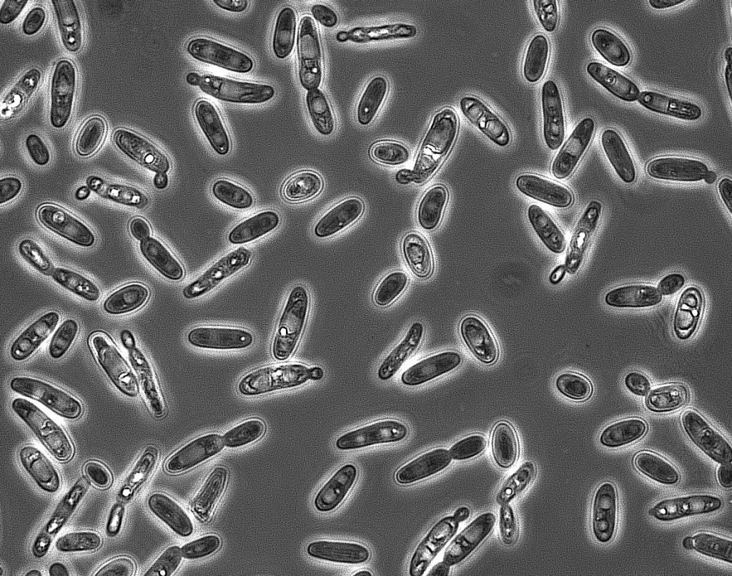
BRETT BEERS:
Saison Brett
100% Brett
Brett IPA
Belgian Tripel DIPA with Brett
Brett Stout
Any Beer can be a Brett Beer The trick is to find a brett strain that gives you the desired flavors to complement your beer.

Slide 4
Brettanomyces: Wild_ish Yeast
Traditionally thought of being a spoiling agent in Wine
Brett DOES NOT make sour beer by itself.
You can ferment beer 100% with Brett as a brewers Yeast
Brett is not always nasty, funky, weird. Newer strains of Brett that have been found and cultured are extremely Fruity.
Brett is an oxidative yeast
Brett can eat the sugars (cellobiose) that remain in the wood of oak barrels
Brett can even eat the unfermentable dextrin.
Brett forms a pellicle- a lumpy white film that coats the top of the beer during fermentation.
Avoid piercing the pellicle
Brett DOES NOT make sour beer by itself.
Super attenuating

Slide 5
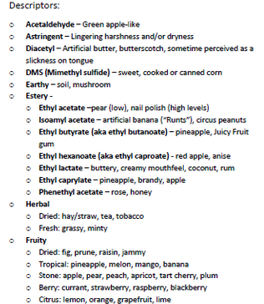
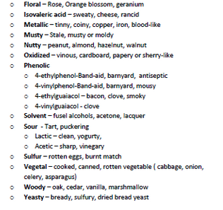
Flavor Profiles of Brett:

Slide 6
Recipe Formulation and Guide for making 100% Brett Beers:
Make a style of beer that will complement the type of Brett you are using.
Your beer will dry out more then if you use Saccaromyces alone so make sure you account for how that will effect body, hop bitterness, etc.
If you want to increase body use 10% oats or wheat. This will help round out your brett beer.
Use 5-10% acid malt. This slight pop in acidity helps bring out the brett flavors.
Don’t use astringent dark grains as much as the astringency is accentuated.

Slide 7
SOUR BEER: Lambic Berliner Weiss Flanders Red Flemish Brown Old Ale Gose American Wild Ale

Slide 8
Pediococcus (bacteria)
Produces loads of lactic acid
Metabolizes glucose into lactic acid without
producing carbon dioxide
Creates diacetyl (Brett eats Diacetyl!)
Gram-positive, in the family of Lactobacillaceae
Normally considered a beer or wine spoiler
Produces a “slimy” or “ropy” character that is composed of carbohydrates, acids, and proteins - This comes out after 3 to 4 months
Sick beer is more acidic
Beer can be sick twice

Slide 9
Lactobacillus (bacteria)
Lactobacillus plays a major role in Flanders type beers, not so much in true Lambics.
Metabolizes sugars aerobically and anaerobically
Lacto is lighter on the palate and is more tart and tangy than sourness derived from Pediococcus.
Lactobacillus delbrueckii produces both lactic acid as well as carbon dioxide as a by product of fermentation.
Lactobacillus will cease to reproduce at a pH of around 3.8
Like most gram-positive bacteria, the presence of certain hop acids will slow the growth of most Lactobacillus.

Slide 10
Acetobacter (BAD bacteria)
Produces acetic acid (vinegar) by oxidizing ethanol to acetic acid.
Many beer souring microorganisms find oxygen or the production of alcohol during fermentation to be detrimental to their viability. Acetobacter requires oxygen to convert alcohol to a acetic acid.
Insects like fruit flies and bees can carry acetobacter.
Not an organism you add, it comes from the vessel and too much oxygen

Slide 11
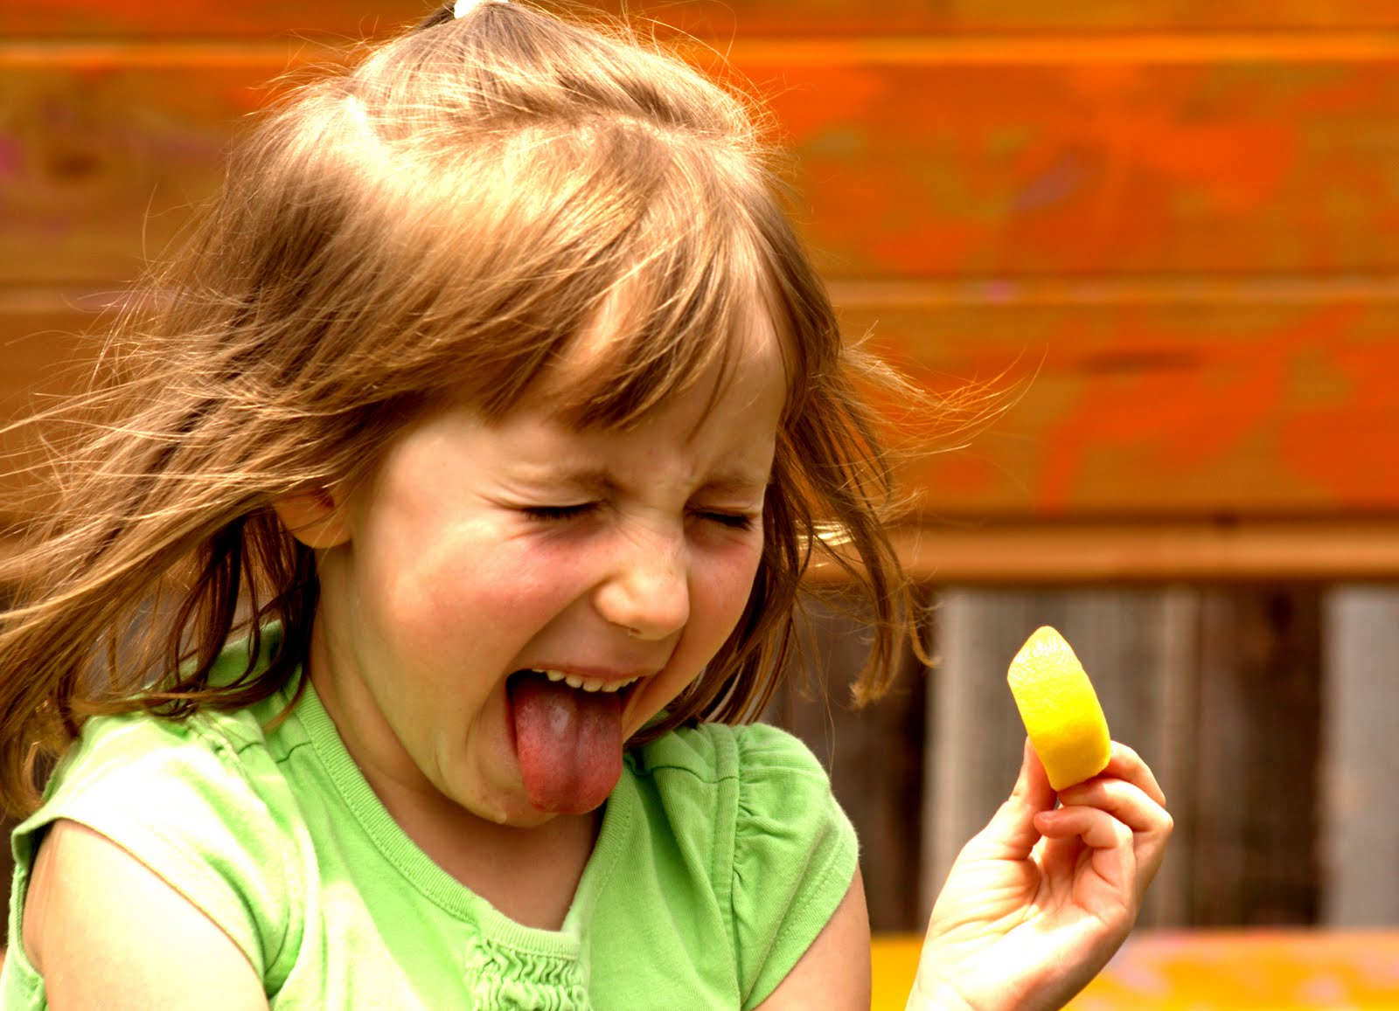
Methods to Making Beer Sour: Sour Mash Acid Malt Blend of Yeast & Souring Bacteria Age in a Barrel

Slide 12
Recipe Formulation and Guide for making Sour Beer
Start with a great recipe!
Mash high to allow for complex sugar formulation (155-160 degrees)
Add adjunct grains to increase flavor and body in the finished product. (Crystal Malts, Oats, Wheat, etc)
Patience (making sour beer takes time)
Leave in Primary Fermentation as long as you want, or transfer to secondary for long aging process.
Want oak flavor, add Oak cubes? I use up to 1.5 oz of medium toast French oak cubes. Boil them for 15 minutes then add them for the duration.
Patience (don’t sample the beer every week). Once every few months is more then enough.

Slide 13
How To Get Started Making Funky Beers?
GET TWO OF EVERYTHING (During and after Fermentation)
Additional Equipment needed
Racking Cane, Bottling Bucket or Keg + bottle filler
1-2 Better Bottles
Patients
Everyone tries, but you can’t make great sour beer fast. It is a 1 year minimum commitment
100% Brett beers can be made in a 3 month time-frame but it isn’t a sour beer.
Artistic Attitude
Blending is an extremely common practice in making sour beers.
Wild yeast is unpredictable and so if a beginner makes palatable beer that is thought of as a success!

Slide 14
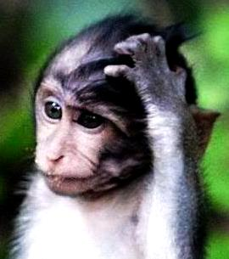
Wild Beers are so weird, who likes them anyways?

Slide 15
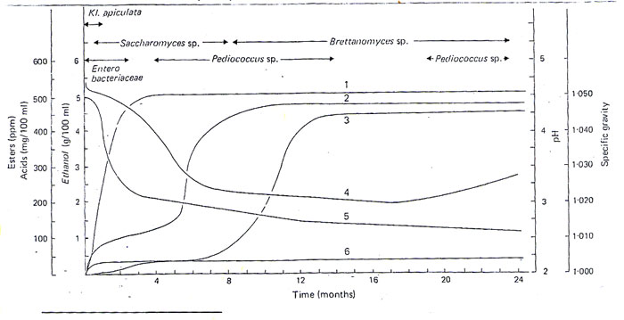
What is really going in Lambic Style Mixed Fermentation?

